Slide 1
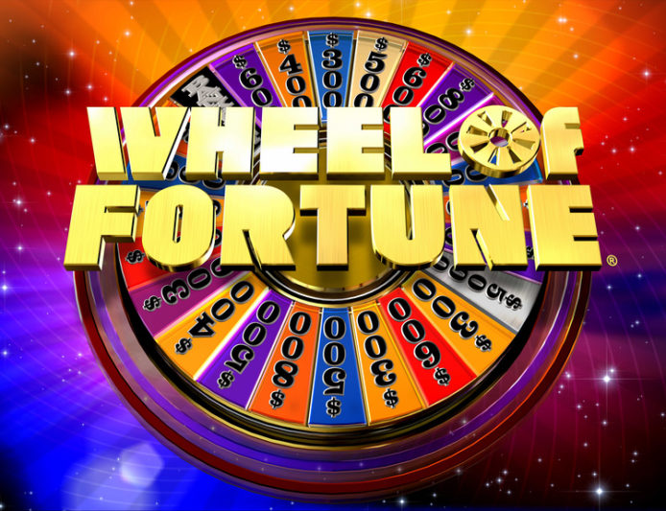
WHEEL OF FORTUNE
Presented by
Radiah Jones
11/07/2019

Slide 2
About Wheel of Fortune
It’s America’s Game!
Wheel of Fortune is a television game show that debuted in 1975 and now has over sixty international adaptations. Three contestants attempt to solve word puzzles to win cash and prizes determined by spinning a giant wheel.
Rules of the Game:
Several successive rounds constitute one entire game. During a player’s turn, they have 3 choices:
1. Spin the wheel - to get a dollar amount and guess a consonant. For each consonant guessed correctly, they accumulate the multiple of that dollar amount. If the consonant they guess is not in the puzzle (or has already been selected), play passes to the next person. If the wheel element chosen is Lose-a-Turn, the player’s turn ends. If the wheel element chosen is Bankrupt, the accumulated total is reset to 0 and the player’s turn ends.
2. Buy a vowel – the player does not spin. The play must pay $250 to guess a vowel and have all occurrences of that vowel shown in the puzzle. If the vowel they guess is not in the puzzle, play passes to the next person.
3. Solve the puzzle – During a player’s turn, if they think they can solve the puzzle, they input their guess. If it is correct, they win the money they have accumulated during the round. Only the player who solves the puzzles gets to keep the money accumulated in a round. If the guess is incorrect, play passes to the next person.

Slide 3
Player
Spin
Buy Vowel
Solve
Bankrupt
$$
Lose Turn
Next Player
- $250 & Guess
Next Player
Next Player & $0
Next Player
Reveal, Update, Play Again
Next Player
$$ to Total
Reveal, Play Again?
Display totals and End
New Puzzle Next Player
Guess
Next Player
$$, Reveal, Update, Play Again
Game Flow

Slide 4
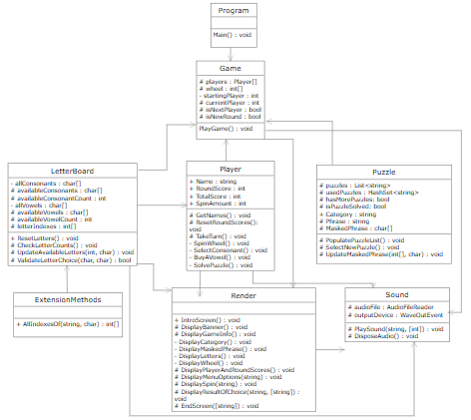
UML

Slide 5
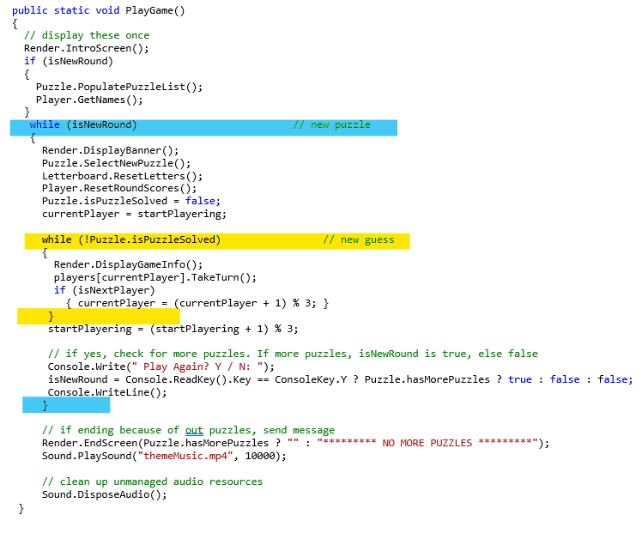
Game logic

Slide 6
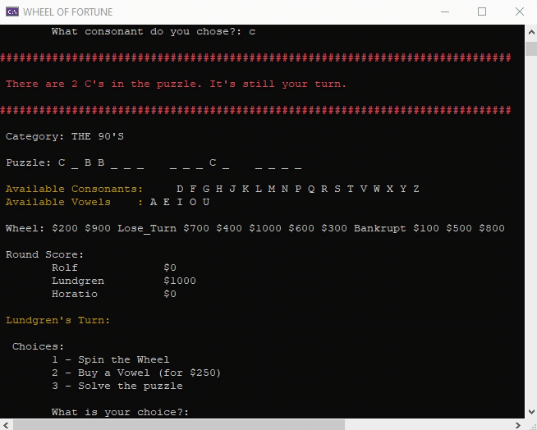
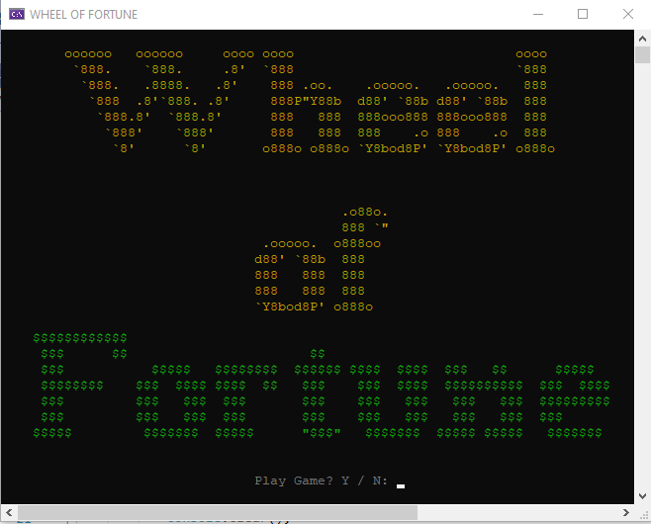
demonstration

Slide 7
Possible Upgrades
Instructions
Multi-player input
Computer Player
Time players for each turn
Bonus Round for player with highest Total Score
Create a Test file
Make extension method generic
Handle puzzles with special characters
Connect to API with unlimited puzzles

Slide 8
Resources
Wheel image: https://blog.margaritaville.com/2018/10/wheel-of-fortune-home-sweet-home/
ASCII art: http://www.network-science.de/ascii/ (Thanks to Melissa Stock)
About Wheel of Fortune: https://en.wikipedia.org/wiki/Wheel_of_Fortune_(American_game_show)
Extension Method: https://stackoverflow.com/questions/10443461/c-sharp-array-findallindexof-which-findall-indexof
Sounds: https://www.soundboard.com/sb/WheeloffortuneFX
Puzzles: https://wheeloffortuneanswer.com/
UML Diagram Website & PowerPoint Template: https://www.draw.io/ (Thanks to Evan Slaton)

